Slide 1

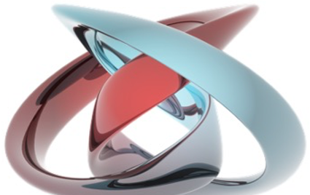
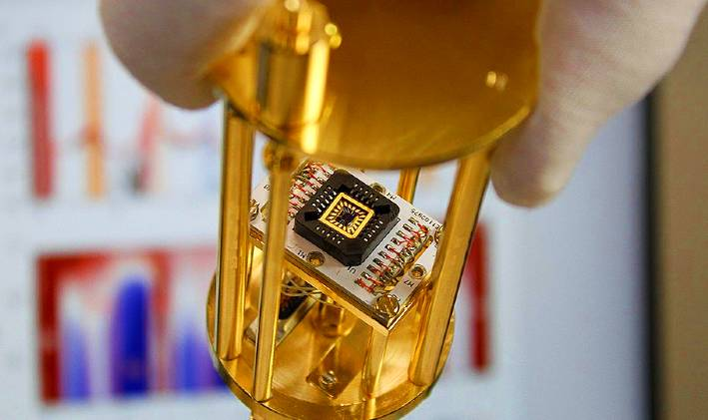
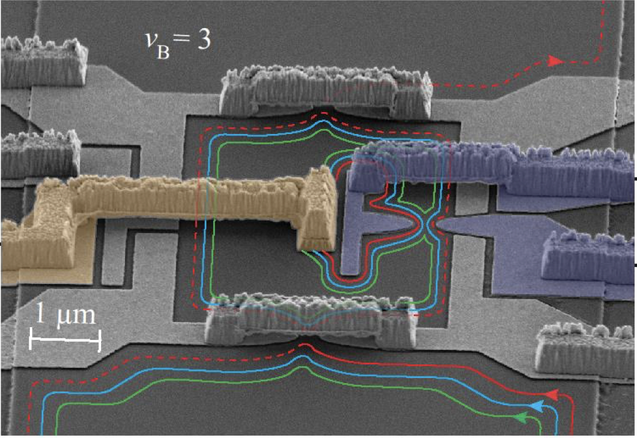
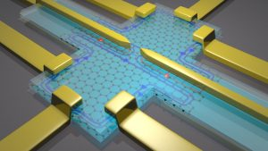
Laboratory of Quantum Physics: Topology and Correlations
Quantum transport in Mesoscopic systems
(PHYS-462)

Slide 2
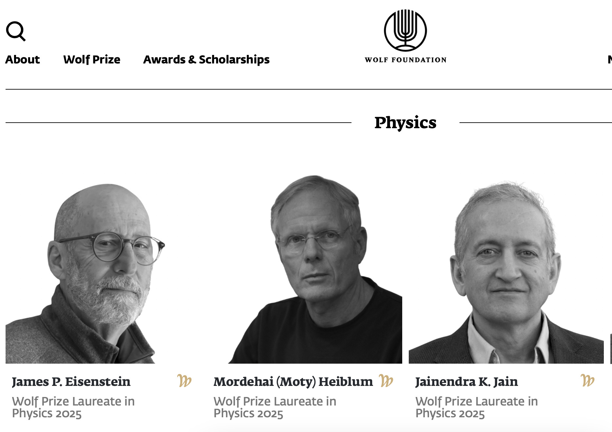
“For advancing our understanding of the surprising properties of two-dimensional electron systems in strong magnetic fields”.

Slide 3
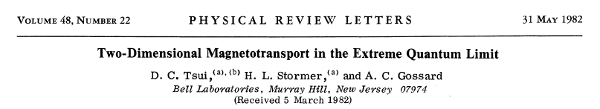
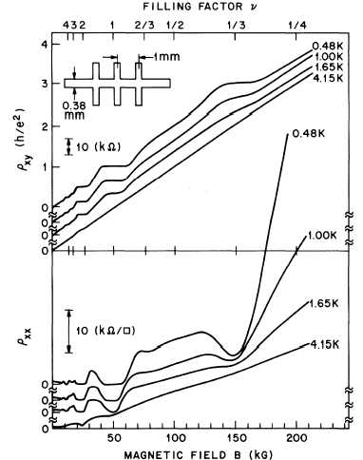
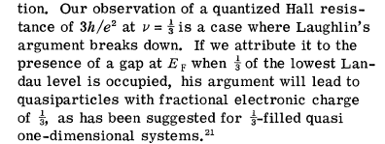
continued with… GaAs MODFET
R_{H} =(e ²/ 3h)⁻¹

Slide 4
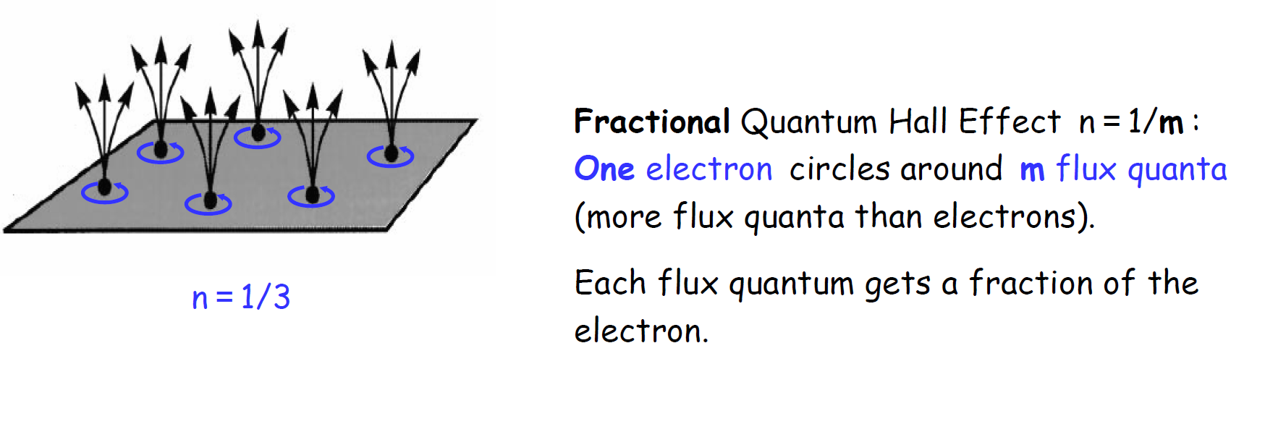
ν = number of electrons per flux quantum

Slide 5
adiabatic ν =1/3…
ohmic contact
ΔΦ=Φ₀
r
J (r )
=e / 3

Slide 6
with time…

Slide 7
standard Hall-bar

Slide 8
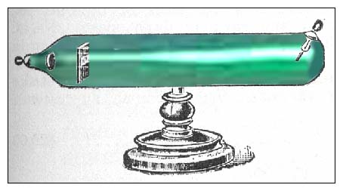
it started with - noise in vacuum tubes
Schottky, 1918
noisy current in vacuum tubes
classical shot noise
cathode
-
+
anode
hot
filament
emitted electrons

Slide 9
classical shot noise
current
time
time
0
large number of impinging electrons
very small escape probability
S_{i} (0)=2 e I
spectral density (A²/Hz)

Slide 10
shot noise =0 …. full Fermi sea (un-partitioned electrons)
V_{applied}
~h/eV_{applied}
zero- temperature ordered electrons are noiseless !
Khlus 1987
Lesovik 1989

Slide 11
during measurement time τ …… total charge transferred Q
charge fluctuations :
stochastic
(A²/Hz)
spectral density of current fluctuations

Slide 12
shot noise - single channel
incoming
transmitted
poissonian
S =2eI
Schottky formula
t <<1
binomial
S =2eI (1-t )
t

Slide 13
similar conductance - different shot noise
g =e ²/ 3h
noise → e* = e
e
e
e
t
h/eV
g =e ²/ 3h
e / 3
e / 3
e / 3
noise → e* =e/3
t
3h/eV

Slide 14
shot noise, T > 0
V = 0 ……….. S_{i} (0) = 4k_{B}Tg ……….thermal
T = 0 ……….. S_{i} (0) = 2qI (1-t )……..shot
E_{F}
E_{F}
n (E )
n (E )
V , T > 0 …………………………………….total

Slide 15
quantum point contact (QPC)
V_{gate}
V_{source}
t
0 < t < 1
QPC
λ_{F}
r

Slide 16
conductance and shot noise in QPC
QPC
I
2DEG
V_{g}
3
3 modes
t₂=1
current responsible
for noise = V g₀ t_{i}
2
conductance (g₀)
1
t₁=1
S ∝ t (1-t )
noise
gate voltage, V_{g}

Slide 17
excess shot noise in QPC
8
3.0
T=1.5 K
two-terminal
6
2.5
4
2.0
Conductance (e ²/ h)
I
2
V
1.5
Noise, S_{i} (10 ⁻²⁶ A²/Hz)
0
1.0
0.5
0.0
-0.9
-0.8
-0.7
-0.6
-0.5
-0.4
-0.3
Gate Voltage, Vg (V)
Reznikov et al. 1995
Kumar et al. 1996

Slide 18
shot noise in QPC
- experimental results -
/Hz)
2
6
A
-28
T =57 mK
(10
t =0.37
4
I
2
current noise, S
0
0
1
2
3
current, I (nA)

Slide 19
preferential backscattering of edge channels
V_{gate}
transmitted lower LLs
partitioned LL
reflected higher LLs

Slide 20
will shot noise measure e or e* ?
no
partition
ν=1/3
v_{QPC} ~0
weak
coupling
e
n=1/3
n=1/3
v_{QPC} ~1/3
strong
coupling
e*=e/3
n=1/3
n=1/3

Slide 21

partitioning edge modes
noiseless current
noisy current
I_{imp}
I_{imp}t
S
QPC
four-terminal measurement
constant amplifier input resistance
noisy current
t
FQHE
quasiparticles in edge modes are plasma-like waves - charge is not defined
shot noise measures the backscattered charge through the bulk (in the QPC)
1
t < 1
noise
negative voltage on split-gate

Slide 22
amplifier input G_{Q}
non-linearity of QPC irrelevant
bulk filling factor
4/9
δ
g
measurement points
3/7
3
t₃
filling factor in QPC
2/5
t₂
1/3
δg
2
Conductance ( g₀ )
t₁
g
1
negative QPC gate voltage

Slide 23
experimental considerations
2DEG : n_{s}=1.1x10¹¹ cm⁻² ; μ=4 x10⁶ cm²/Vs
shot noise signal S_{i}(0)=2e*I=10 ⁻²⁹ A²/Hz ...…………… T*~ 40 mK
Johnson noise……………………………………………. T ~ (10-30) mK
noise in ‘warm electronics’……….....……………………T*~ 3.5 K
“home made” (MODFET) cryogenic preamplifier (T= 4.2 K)
T*~100-200 mK at f₀ = 1 - 4 MHz (above 1/f noise knee)

Slide 24
difficulties in measurements
(cold, 50 mK)
coaxial cable
(hot, 4.2 K)
δV=R δi
60cm 60pF
cooled
preamp
spectrum
analyzer
(δ i)²
QPC
R
QPC resistance R ~ 100 kΩ
coax capacitance C ~ 60 pF
f_{max} = 1/(2π RC) ~ 30 kHz
1/f noise is large

Slide 25
experimental setup
frequency above 1/f noise corner of preamplifier;
capacitance compensated by resonant circuit;
calibration signal
cryostat
50 Ω ; 300 K
averaging time,τ
C<<
voltage gain = 1000
DC current
f₀ ,Δf₀
noise <i²>
cooled
preamp
warm
preamp
V_{DC}
1 GΩ
‘home made’
L
C
R
spectrum
analyzer
QPC
coax

Slide 26
ν =1/3
1-t ~ 0.01
V
=-0.03V
g

Slide 27
v=2/5 bunching
1-t ~ 0.01
ν = 2/5
bunching of quasiparticles
charge = filling factor

Slide 28
temperature dependence ν =2/5
bunching of quasiparticles at low temperatures
similar effect at v=3/7…

Slide 29

Anyons
Introducing Anyons
Let’s first recall the usual argument that tells us we should restrict to boson and fermions. We take two identical particles described by the wavefunction ψ(_{r1}, r₂). Since the particles are identical, all probabilities must be the same if the particles are exchanged. This tells us that |ψ(r1, r2)|² = |ψ(r2, r1)|² so that, upon exchange, the wavefunctions differ by at most a phase
Now suppose that we exchange again. Performing two exchanges is equivalent to a rotation, so should take us back to where we started. This gives the condition
This gives the two familiar possibilities of bosons (α = 0) or fermions (α = 1).

Slide 30
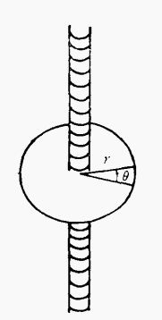
Anyons
Introducing Anyons
Suppose a particle with an electrical q moves in a circular motion in a plane，the z component of the angular momentum of the electron, L_{z}, is conserved, and the eigenwave function, under the symmetric specification and the orbital angular momentum operator of a particle(enginvalue is mħ)
The unlimited-length fine spiral pipe with a current is now allowed to pass through the center of the circle along the square direction perpendicular to the particle motion plane , and the current changes with time, so the flux towel through any section of the screw tube also changes at any time.The particle will experience a vortex 'sensing' electric field

Slide 31
Anyons
The moment of force opposite the center of the circle (along Z square) is
According to the angular momentum theorem
Therefore, the variation of orbital angular motion is caused by the variation of magnetic flux dΦ during Δt

Slide 32
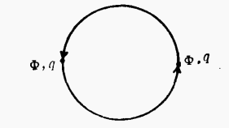
Anyons
Therefore, there exists the orbital angular motion of the magnetic field of the fine spiral pipe
The charged particle-magnetic flux tube composite is regarded asa whole, which will have peculiar statistical properties.

Slide 33
Anyons
Try to interchange the phases of two such composites.
The process can be seen as each complex body rotated around the center of mass with angle π
Each composite acquires an additional angular momentum of under the vector potential of the other,the wave function describing the system acquires additional phase factors
exp((-iqΦ/2π)/*π)
The change of the system wave function is:
θ=π,exp((-iqΦ/2π)/*θ)=exp((-iqΦ/2π)/*π)=exp(-iqΦ/2π)
qΦ/2=nπ.n is odd, then, the composite is fermion
qΦ/2=nπ.n is even, then, the composite is Boson
Howeve, qΦtake any value, this means that the statistical properties of the complex can be continuously changed between Fermi statistics and Bose statistics, so the complex is named as any vector

Slide 34

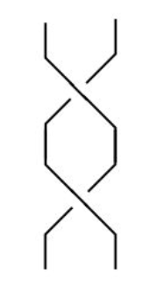
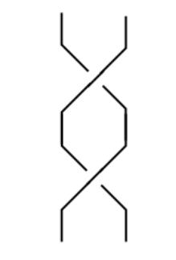
Anyons
In d = 3+1 spatial dimensions, the path that the pair of particles take in spacetime can always be continuously connected to the situation where the particles don’t move at all. This is the reason the resulting state should be the same as the one before the exchange. But in d = 2+1 spatial dimensions, this is not the case: the worldlines of particles now wind around each other. When particles are exchanged in an anti-clockwise direction, like this worldlines get tangled. They can’t be smoothly continued into the worldlines of particles which are exchanged clockwise, like this:

Slide 35
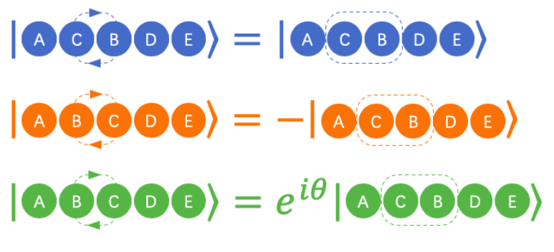

Anyons
Each winding defines a different topological sector. The essence of the loophole is that, after a rotation in the two-dimensions, the wavefunction may retain a memory of the path it took through the phase. This means that may have any phase α. In fact, we need to be more precise: we will say that after an anti-clockwise exchange, the wavefunction is
After a clockwise exchange, the topological properties of the path will be retained, so that the phase can seem to take any value rather than just 0,1, in which case swapping two particles produces a random phase, and any particle that satisfies this swapping law is an arbitrary particle are referred to as anyons. This whole subject usually goes by the name of quantum statistics or fractional statistics. But it has less to do with statistics and more to do with topology

Slide 36
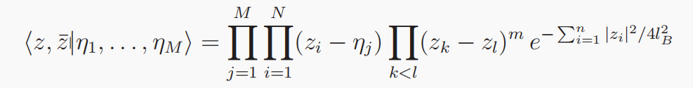

Fractional Statistics
Fractional Statistics:We will now compute the quantum statistics of quasi-holes in the ν = 1/m Laughlin state.
We consider a state of M quasi-holes which we denote as |η₁, . . . , η_{M}>,The wave function is
Compute the Berry phase, we should work with the normalised states. We’ll call this state |ψ>, defined by

Slide 37
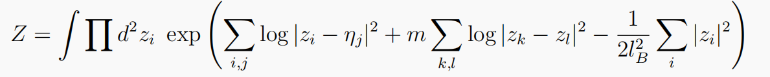

Fractional Statistics
where the normalisation factor is defined as Z = <η₁, . . . , η_{M}|η₁, . . . , η_{M}>, which reads
This is the object which plays the role of the partition function in the plasma analogy, now in the presence of impurities localised at η_{i}.The holomorphic Berry connection is

Slide 38
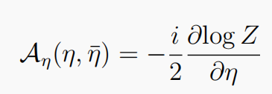

Fractional Statistics
But because |η> is holomorphic, and correspondingly <η| is anti-holomorphic, we have :
∂Z/∂η = ∂/∂η <η|η> = <η| ∂/∂η |η>
So we can write
Meanwhile, the anti-holomorphic Berry connection is

Slide 39
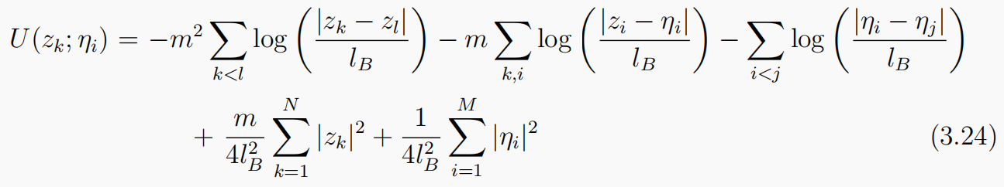
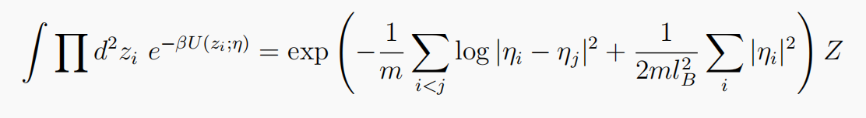
Fractional Statistics
The correct potential energy for the plasma with M impurities should therefore be
The corrected plasma partition function is then

Slide 40
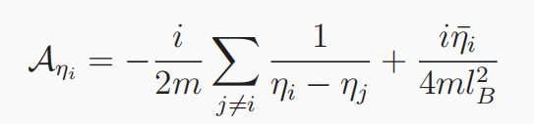
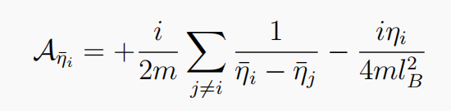
Fractional Statistics
The correct potential energy for the plasma with M impurities should therefore be
where we stress that these expressions only hold as long as the quasi-holes do not get
too close to each other where the approximation of complete screening breaks down.
We can now use these Berry connections to compute both the charge and statistics of
the quasi-hole.

Slide 41

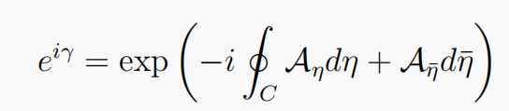
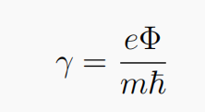
Fractional Statistics
Let’s start by computing the charge of the anyon. The basic idea is simple. We pick one of the quasi-holes — say η1 ≡ η — and move it on a closed path C. For now we choose a path which does not enclose any of the other anyons. This ensures that only the second term in the Berry phase contributes,
After traversing the path C, the quasi-hole will return with a phase shift of eiγ, given by the Berry phase

Slide 42


Fractional Statistics
where Φ is the total magnetic flux enclosed by the path C. But there’s a nice interpretation of this result: it’s simply the Aharonov-Bohm phase picked up by the particle.So the quasiparticle charge is

Slide 43
Composite Fermions
Composite Fermions
In 1989, Jain proposed the theory of composite Fermions and introduced the concept of composite Fermion (CF). Each composite fermion consists of an electron carrying 2p quantum magnetic flux ϕ₀=hc/e. This composite fermion senses removing 2pn_{e}ϕ₀ effective magnetic field B*=B-2pn_{e}ϕ₀ and forms its own "Landau level," which will later be called the Lambda level to distinguish it from the Landau level of the electron.
According to this theory, the so-called fractional quantum Hall effect is that the composite fermions fill the Lambda energy levels to form an effective integer quantum Hall effect.
Therefore, the filling number ν of complex fermions and the actual filling number ν* of electrons should satisfy the relationship:
For example, for 1/3 FQHE, each composite fermion carries two quantum magnetic flux (P =1), occupying the first Lamba energy level (ν*=1),for 6/13 state,(ν* =6)/13=6/(2×1×6+1),That is, the sixth energy level of a complex fermion carrying two quantum magnetic flux.

Slide 44
Composite Fermions
CF postulate:To minimize the interaction energy, each electron in the LLL captures an even number (2p)
of quantum mechanical vortices to transform into entities called composite fermions, which
themselves can be treated as weakly interacting fermions to a good first approximation.
The vortex, by definition, is an object that produces a phase of 2π for a closed loop around it.where the vortex is modeled as a flux quantum ϕ₀, which also has the property that a closed loop around it produces an Aharonov Bohm phase of precisely 2π.
The compositefermions are depicted as electrons with vertical arrows attached to them, each arrow representing a quantized vortex(or a flux quantum).
In other words, the only essential role of interactions is to create composite fermions. As seen below, due to the Berryphases originating from the bound vortices, composite fermions experience an effective magnetic field: B*=B-2pn_{e}ϕ_{0.}
The system of strongly interacting electrons in magnetic field B thus transforms into a system of weakly interacting composite fermions in an effective magnetic field B∗.

Slide 45
Composite Fermions
Composite Fermions
In addition, we can obtain the relationship between the effective magnetic field and the primary magnetic field:
The interaction intensity of the composite fermions in the first landau energy should be in the form of Coulomb interaction:
l_{B} is the magnetic length, ε is the dielectric constant(permittivity).

Slide 46
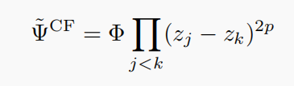
Composite Fermions
Composite Fermions
Let us now define mathematically what various terms mean in the preceding paragraph. The meaning of electrons capturing vortices implies the following form for the wave function:
where Φ is an antisymmetric wave function for electrons. The Jastrow factor ensures that each particle sees 2p vortices on every other particle. The bound state of the electron and the vortices is interpreted as a particle, called composite fermion. It is easy to see that Ψ˜ ^{CF} is very efficient in keeping electrons away from one another, i.e. has good correlations in the presence of repulsive interactions. The probability of finding two electrons at a short distance r vanishes as
r^{2(p+1)} for Ψ˜^{CF}, which is much faster than the r² behavior required by the Pauli principle.

Slide 47

Composite Fermions
Composite Fermions
We would also like to have strictly LLL wave functions. We can imagine obtaining these by an “adiabatic continuation” of the above wave function to the LLL, but it is not known how such an adiabatic process can be implemented. Given that the mixing with higher LLs is small anyway, we assume that the LLL state can be obtained by a straight LLL projection of the wave function, i.e. throwing away the part of this wave function that resides in higher Landau levels.This gives us the “final” expression for the wave function:

Slide 48
Composite Fermions
Composite Fermions
Read et al. proposed that, in the case of, v*⟶ ∞, there is B*⟶ 0,ν=1/2p. This is known as The Fermi Sea of composite fermion.The ground state wave function constructed according to this theory is:
The wave function of the electron at the Nth Landau level
Each electron plus 2p quantum magnetic flux becomes the wave function of the composite Fermion
The composite Fermi wave function is projected onto the first Lambda energy level.
In particular, this wave function will return to Laughlin wave function when n=1.

Slide 49
Composite Fermions
Due to the formation of composite fermions, the LLL splits into Λ levels of composite fermions that are analogousto LLs of electrons in an effective magnetic field. Gapped states are obtained when the CF filling is integer, i.e. ν∗ = n,which corresponds to the electron filling factors given by
In other words:
FQHE of electrons = IQHE of composite fermions
At ν = 1/2, where B = 2pρϕ₀, composite fermions experience no effective magnetic field, i.e. we have B∗ = 0. Composite fermions form a Fermi sea here (Halperin, Lee and Read),Because the Fermi sea has no gap, no FQHE results here
1/2 filled LL = CF Fermi sea

Slide 50
The adiabatic approximation
Imagine a system: perfect pendulum(no friction, air resistance,etc.)
Adiabatic process with gradual change of the external conditions depends on two charactristic time:
T_{i}: the internal time representing the motion of the system itself (pendulum osillations)
T_{e}: the external time over which the parameters of the system change appreciably(pendulum on a vibrating platform, the period of the the paltform motion)
Adiabatic process: T_{e}>>T_{i}
The adiabatic theorem in Quantum mechanics:
Suppose the Hamiltonian changes gradually from initial form H^{i} to final form H^{f}
if the particle was initially in nth eigenstate of H^{i}, it will be carried into nth enginstate of H^{f}

Slide 51
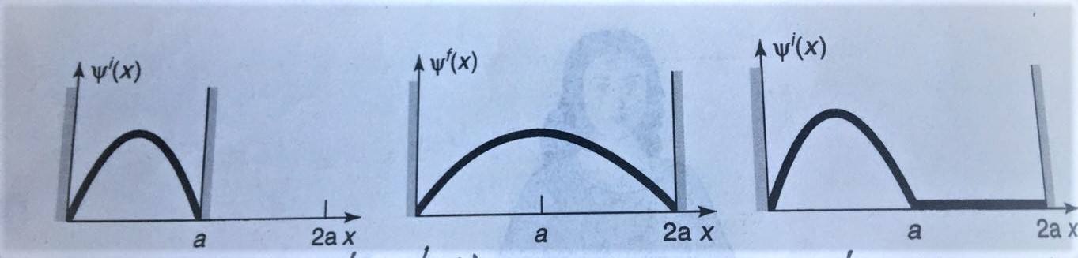
The adiabatic approximation
A particle in the ground state of the infinite square well:
The wavefunction of the ground state at the initial Hamiltonian:
Gradually move the right well to 2a, at the adiabatic theorem:

Slide 52
Proof of the Adiabatic Theorem
If the H,V is independent of time t,we could solve the S-E by the method of Separation of variables,ψ is function of x alone and φ is a function of t alone,
A partial differential equation into two ordinary differential equation!

Slide 53
Proof of the Adiabatic Theorem
If the potential is independent of time, the general solution to the (time-dependent)S-E is

Slide 54
Proof of the Adiabatic Theorem
the constant c_{n} is determined by the initial function,Ψ(r,0). if the potential admits continum states, then the sum becomes an integral.
If the Hamiltonian changes with time

Slide 55
Proof of the Adiabatic Theorem
From the equation:

Slide 56
Proof of the Adiabatic Theorem
Differentiating the equation:

Slide 57
Proof of the Adiabatic Theorem
From the adiabatic approximation:assume that the time derivative of H is extremely small, drop the second term

Slide 58
Berry Phase
The solution:
If the initial state of the system is in the Nth eigenstate, that if c_{n}(0)=1,
Dynamic phase
Adiabatic phase factor
Geometric phase
The wavefunction still remains in nth eigenstate of the time envolving Hamiltonian!

Slide 59
Berry Phase
Start: nth enginstate of H(0) Final:nth enginstate of H(t)
Under adiabatic condition, picking up a time-dependent phase factor
Note that ψ_{n}(t) depends on t due to there is some parameter R(t) in the Hamiltonian that is changing with time（The width of expanding square well）

Slide 60
Berry Phase
Note that ψ_{n}(t) depends on t due to there is some parameter R(t) in the Hamiltonian that is changing with time（The width of expanding square well）

Slide 61
Berry Phase
Suppose there are N of parameter in the Hamlitonian changing with time:
If the Hamiltonian returns to its initial form after time T, the net geometric phase change (Berry Phase)is:

Slide 62
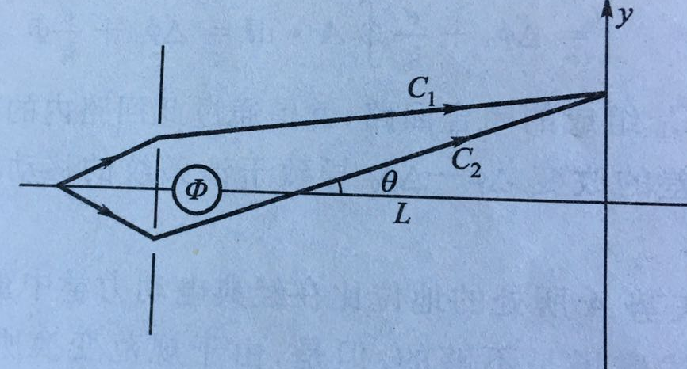
Berry Phase- AB effect
The Aharonov-Bohm effect can be regards as an example geometric phase.
Starts from Electron double slit diffraction experiment^{[2]}:
The electrons emitted from the gun pass through a double slit into two beams and interfere with the screen.If a thin solenoid is placed behind the double slit, the interference fringe is found to move when the solenoid is only producing a magnetic field in the tube with an electric current.
[1]Aharonov Y,Bohm D,Phys.Rev.1959,115;485,
[2]Chambers R G. PRL.1960,5;3

Slide 63
Berry Phase- AB effect
When the solenoid has internal magnetic flux Φ，Electrons pass through outer spaceB=0，A≠0，
The vector potential A has observable physical effects, which can affect the phase of the electron beam and cause the interference fringes to move.
In quantum mechanics, the free electron state can be represented by plane wave,the wave function is:
[1]Aharonov Y,Bohm D,Phys.Rev.1959,115;485,
[2]Chambers R G. PRL.1960,5;3

Slide 64
Berry Phase- AB effect
When the solenoid has internal magnetic flux Φ，Electrons pass through outer spaceB=0，A≠0，
When thers no current in solenoid:
When thers is current in solenoid:
[1]Aharonov Y,Bohm D,Phys.Rev.1959,115;485,
[2]Chambers R G. PRL.1960,5;3

Slide 65
Berry Phase- AB effect
When the solenoid has internal magnetic flux Φ，Electrons pass through outer spaceB=0，A≠0，
When thers is current in solenoid,the phase difference between two electron beams:
[1]Aharonov Y,Bohm D,Phys.Rev.1959,115;485,
[2]Chambers R G. PRL.1960,5;3

Slide 66
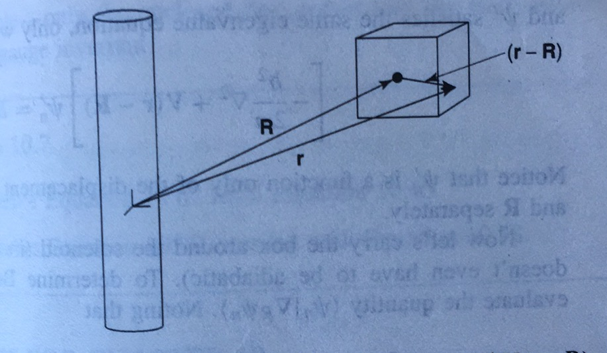
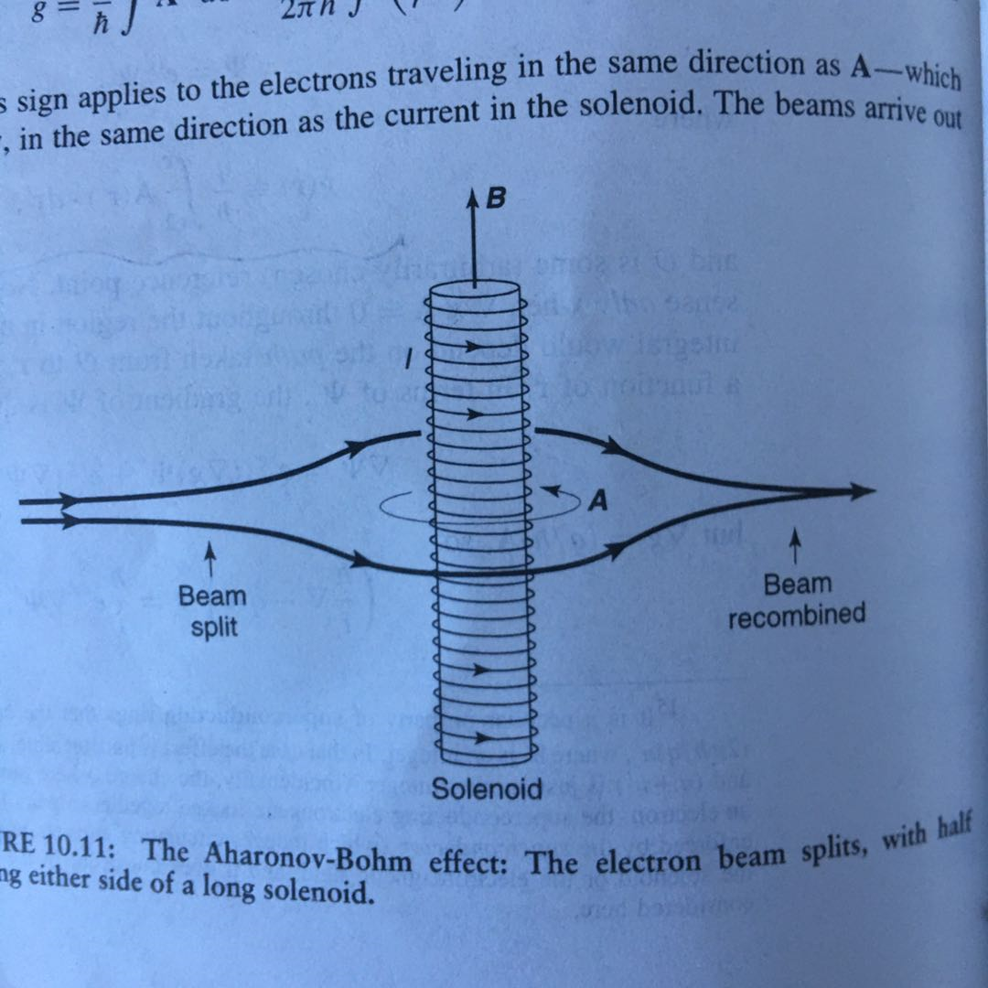
Berry Phase- AB effect
The Aharonov-Bohm effect can be regards as an example geometric phase.
Suppose the charged particle is confined to a box,which is centered at point R, the eigenfunctions of the Hamiltonian are determined by(From the adiabtic theroem):

Slide 67
Berry Phase- AB effect
The Aharonov-Bohm effect can be regards as an example geometric phase.
Find the Berry phase :
[2]Chambers R G. PRL.1960,5;3

Slide 68
Berry Phase- AB effect
The Aharonov-Bohm effect can be regards as an example geometric phase.
[2]Chambers R G. PRL.1960,5;3

Slide 69
Berry Phase- AB effect
This results confirm the AB effect and reveals that AB effe is a particular instance of geometric phase(Berry phase)!.
[2]Chambers R G. PRL.1960,5;3

Slide 70
Quantization of Hall Conductance
Hall conductance can be obtained by calculating the first chen-number. The core is the berry phase which is derived from arbitrariness of the wave function, and it is a geometric phase reflecting the topological properties of the system.
Definite a Berry phase,Berry connection,Berry curvature:
Berry phase is the integral of berry connection of a closed loop in parameter(Used to explain quantum Hall conductance in topological band theory, here,momentum) space, it's also the surface integral of Berry's curvature in parametric space(The entire Brillouin district)

Slide 71
Quantization of Hall Conductance
Hall conductance can be obtained by calculating the first chen-number. The core is the berry phase which is derived from arbitrariness of the wave function, and it is a geometric phase reflecting the topological properties of the system.
Definite a Berry phase,Berry connection,Berry curvature:
Berry phase is the integral of berry connection of a closed loop in parameter(Used to explain quantum Hall conductance in topological band theory, here,momentum) space, it's also the surface integral of Berry's curvature in parametric space(The entire Brillouin district)

Slide 72



Quantization of Hall Conductance
If the parameter space is three dimensional, the Barry curvature can be written as the following pseudovector:
By Stokes' theorem, Barry phase can be expressed as a surface integral in three dimensional parametric space
S is the surface enclosed by loop.
In conclusion, Barry curvature can be regarded as "magnetic field intensity" in parameter space, Barry connection as "magnetic vector potential", and Barry phase as "magnetic flux".

